Slide 1


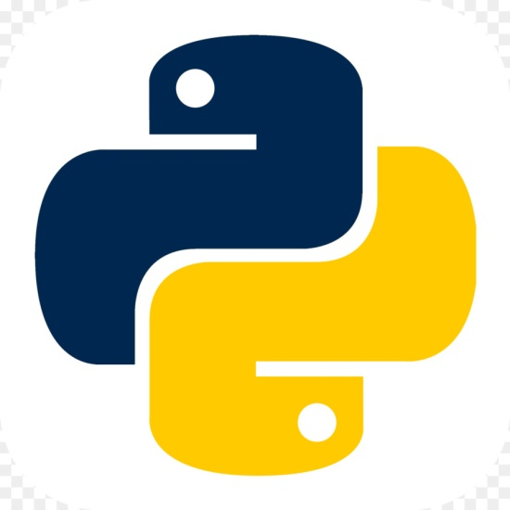

Netaji subhash engineering college
phoenix
Presents
Computing using python

Slide 2
Computing using python
“The joy of coding Python should be in seeing short, concise, readable classes that express a lot of action in a small amount of clear code -- not in reams of trivial code that bores the reader to death.” --Guido van Rossum
Devjeet Roy
Full Stack Web Developer & ML Enthusiast
Technical Lead, Phoenix
NETAJI SUBHASH ENGINEERING COLLEGE

Slide 3
History of Python
Developed By | Guido Van Rossum
Location | Centrum Wiskunde & Informatica (CWI) in the Netherlands
Year | 1989
Programming Paradigm | Procedural Programming Object Oriented Functional Programming

Slide 4
Why do we learn Python ?
Python is one of the few languages that rules the world of Data Science & Machine Learning
Python is also used for Backend Web Development using Django & Flask
Python language can also be used for Android Development
Python is also used for Automation in IoT
It enables us to do GUI programming

Slide 5
Is Python a Scripting Language?
Yes, Python is a scripting language. It is often applied in scripting
roles. Python is actively taking over the Java, PHP, C++, C, bash,
PERL, Ruby, etc., reducing developer’s effort in creating
standalone, web, gaming, enterprise, and various other
applications. People use the word ‘script’ instead of ‘program’ to
describe a Python code file.

Slide 6
Downside of Python
Python is slower than C or C++.
Python is not a very good language for mobile development . It
is seen as a weak language for mobile computing.
Python is not a good choice for memory intensive tasks. Due to
the flexibility of the data-types, Python's memory consumption
is also high.

Slide 7
Features of Python
It is Object Oriented Programming Language.
It is Free.
It has multipurpose use.
It is Mixable.
It is very easy to learn and use.

Slide 8
Python Interpreter
Step 1 : The interpreter reads and verifies that the instruction is well formatted, i.e. it checks the syntax of each line. If it encounters any error, it immediately halts the translation and shows an error message.
Step 2 : Then interpreter translates it into its equivalent form in intermediate language called “Bytecode”. Thus, after successful execution of Python script or code, it is completely translated into Byte code.
Step 3 : Byte code is sent to the Python Virtual Machine(PVM).Here again the byte code is executed on PVM.If an error occurs during this execution then the execution is halted with an error message.

Slide 9


Invoking the Python Interpreter
C:\Users\abc> python

Slide 10
The Interactive Python
The simplest way to run Python commands is in Python’s
interactive command line. It is also known as the interactive
prompt. It can be used from IDLE.
If you are interested to run it from Windows Command Line, you
need to add it tin PATH.

Slide 11
Let’s play with Interactive Mode
print “Hello World!” in Python

Slide 12
Outside the Interactive Mode
You can use a Text Editor like VS Code, Atom, Sublime etc to
write the Python script and can use the Windows Command Line
Or Embedded Terminal to invoke the Python interpreter.

Slide 13
What are we going to learn?
Conditional Statement
Looping and Iteration
Functions
Data Structure using Python

Slide 14
What’s next ?
Data Science using Python
-> Data Analytics
-> Machine Learning
-> Natural Language Processing
-> Deep Learning
-> Artificial Intelligence
Bioinformatics
Computational Neurology
Web Development
-> Django
-> Flask
Android Development
-> Kivy
GUI Development
-> Tkinter

